Slide 1
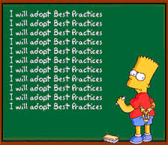
ISO/TC211 Ad hoc group on best practices for UML modelling
Report to the plenary
2014-11-26

Slide 2

Vision:
UML models that can be understood by both humans and machines

Slide 3
Progress report
Call for members September 2014
9 nominated experts
Other resources
19 members in the group on Livelink
Set up Livelink site with discussion forum
Investigated possible sites for a UML BP wiki
Initial discussions on topics to include
Started temporary wiki on Github
Meeting in Shenzhen
14 patricipants from 11 countries

Slide 4
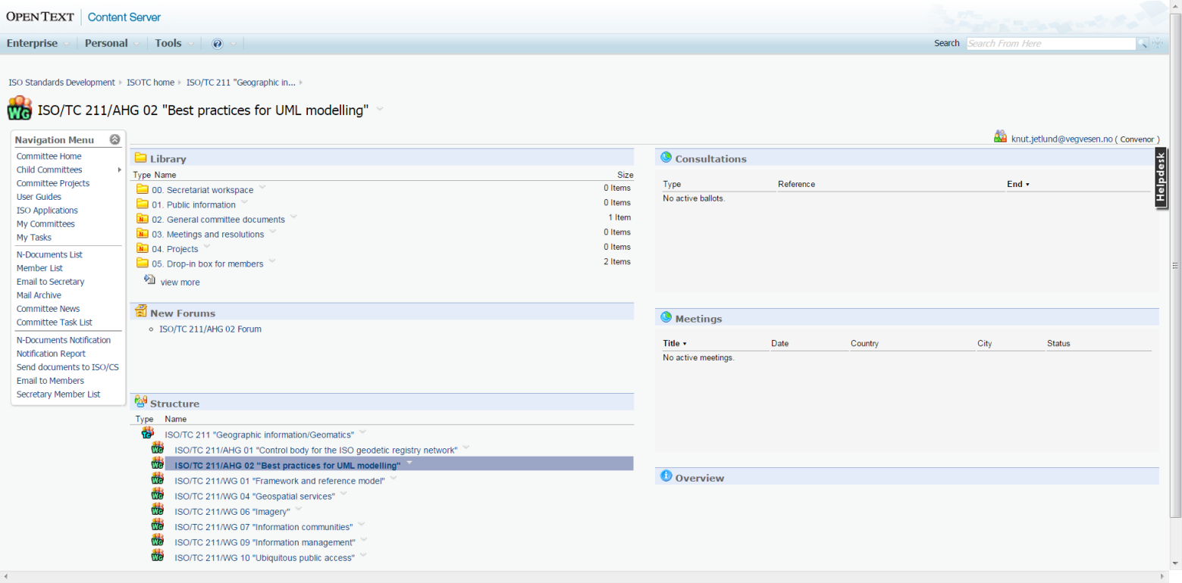
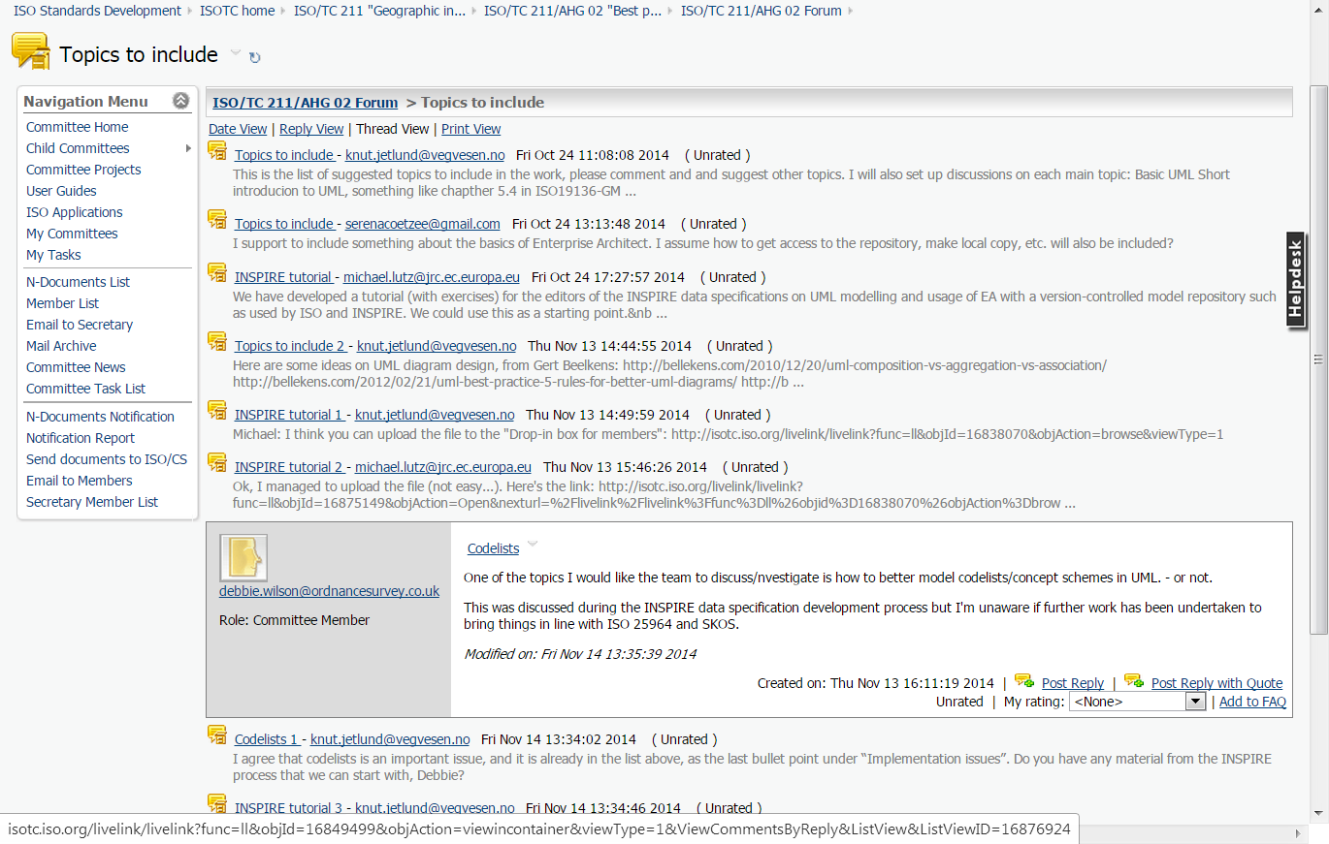
Livelink site
http://isotc.iso.org/livelink/livelink?func=ll&objId=16823611&objAction=browse&viewType=1

Slide 5
Result presentation – wiki site
OGC Internal
Login to view and edit
OGC External
Open to view, login to edit
ISO TC/211 Wiki
As part of the new isotc211.org
GitHub
https://github.com/ISO-TC211/UML-Best-Practices/wiki

Slide 6
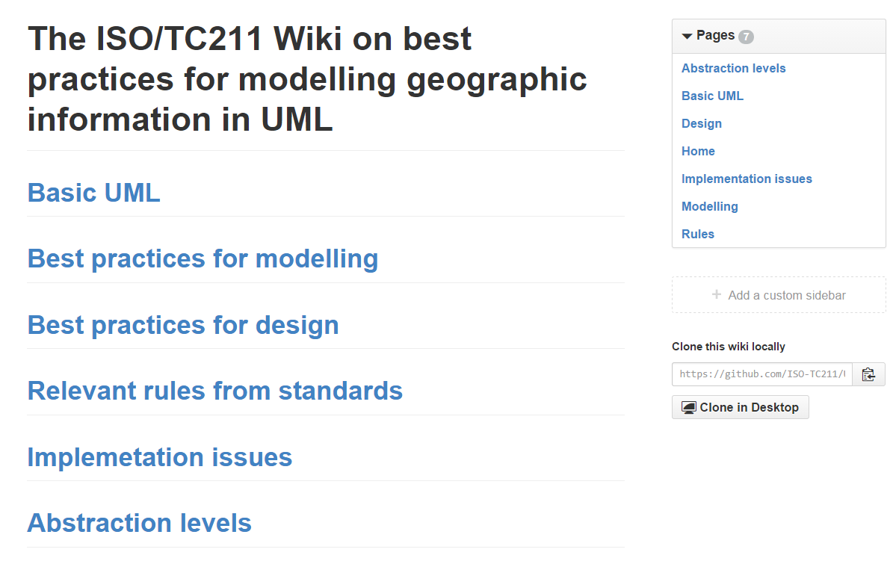
Result presentation – wiki site
https://github.com/ISO-TC211/UML-Best-Practices/wiki

Slide 7
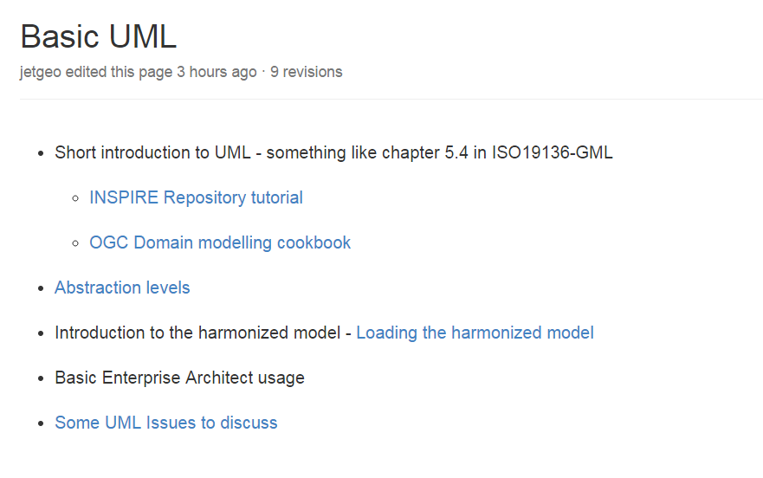
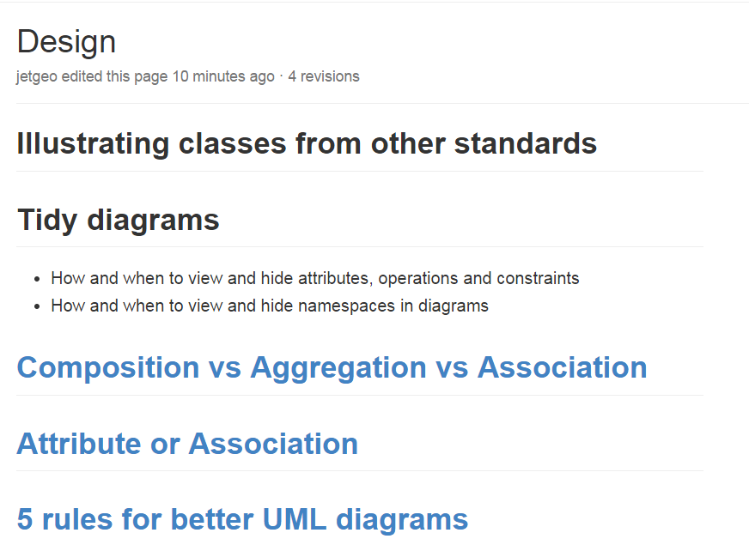
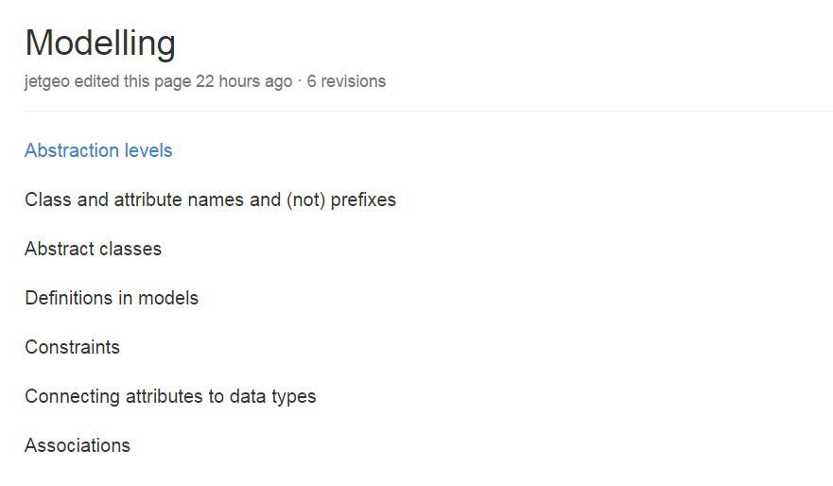
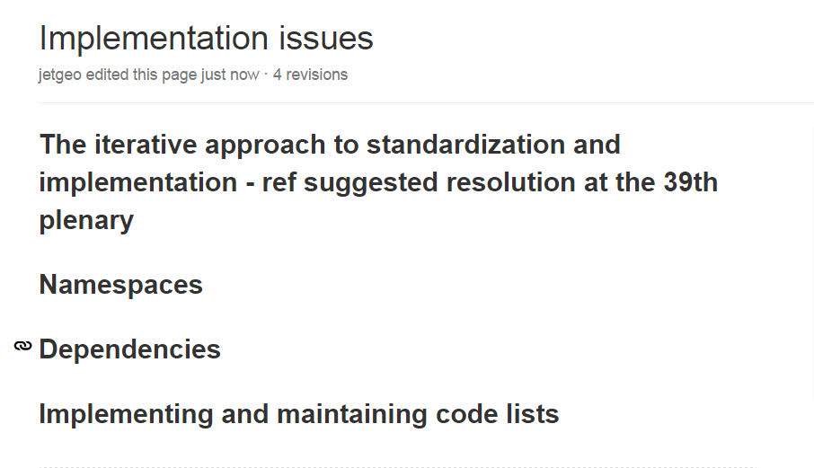
Result presentation – wiki site
https://github.com/ISO-TC211/UML-Best-Practices/wiki

Slide 8
Plan ahead
What:
Describe specific topics on the wiki site
Start with base topics, go into details later
How:
Discussion forum on Livelink
Web meetings when needed
Physical meeting in June 2015 (ISO/TC211 meeting week)
Next:
We should continue the work up to the next meeting week in October/November 2015, maybe longer

